Slide 1
BUILDING RESILIENCE SYSTEMS TO SUPPORT INTERNATIONAL STUDENTS TO CANADA
PATHWAYS TO PROSPERITY VIRTUAL WORKSHOP SERIES
MARCH 4TH 2021
Chair: Valerie Preston
Panelists: Margaret Walton Roberts, Sutama Ghosh, Francine Schlosser, and Luisa Veronis

Slide 2
Indian international students in Canada: Migration trajectories, educational experience and economic outcomes
Margaret Walton-Roberts, Wilfrid Laurier University

Slide 3
Resilience
The Building Migrant Resilience in Cities explores resilience in a broad sense that goes beyond economic success, and poses the question of how migrants develop capacities to overcome settlement challenges (Akbar & Preston 2019). We also pay close attention to views of resilience among key actors in settlement, such as policymakers, service providers, employers, and migrants themselves (Bushell & Shields 2018).
The project argues that deeper understanding of resilience is crucial for enhancing migrant settlement, and this includes institutional resilience. We ask what kind of supports and systems can foster resilience and effectively respond to structural crisis and change, such as the COVID-19 pandemic (Sheilds & Alrob 2020).
Strategies, resources, and networks that migrants employ to cope with daily challenges and major shocks in order to ‘bounce back’ are important, but to cope with and adapt to adversity, policies and institutions must be also be assessed in terms of how they model resilience (Veres, Schlosser, Shahbazi 2018).
For international students we need to understand how resilience works when students are away from their families and moving along multiple/parallel migrant pathways- PR on arrival, vs. “Two step” / temporary/work visa PR.
Also, we need to understand how resilient the policy structures are in terms of operation, composition and outcomes.
Notes:
Shields and Alrob (2020) “COVID-19, Migration and the Canadian
Immigration System: Dimensions, Impact and
Resilience” BMRC report.

Slide 4
International Students in Canada
642,480 international students in Canada as of December 31, 2019
India is the top sending country, over 34%
Rank | Country of Citizenship | 2018 | 2019
1 | India | 171730 | 219855
2 | China | 141995 | 141400
3 | South Korea | 24070 | 24180
4 | France | 22540 | 24045
5 | Vietnam | 20185 | 21595
6 | United States of America | 14440 | 15015
7 | Iran | 10535 | 14745
8 | Brazil | 13770 | 14560
9 | Nigeria | 11190 | 11985
10 | Mexico | 7805 | 8710
Source: https://open.canada.ca/data/en/dataset/90115b00-f9b8-49e8-afa3-b4cff8facaee
Notes:
A study by Global Affairs Canada shows international students spent $21 billion in Canada in 2018, providing more to the economy than the export markets for car parts, lumber or aircraft

Slide 5
Subject areas studied 2009 – 2020 International students (Total and India)
Area of Study | Total | India | Percent | (%)
Agriculture, Agriculture Operations and Related Sciences | 3,539 | 809 | 22.86
Architecture and Related Services | 5,696 | 1,174 | 20.61
Arts, Fine/Visual/Performing | 38,568 | 3,970 | 10.29
Arts/Humanities/Social Science | 165,349 | 19,399 | 11.73
Biological and Biomedical Sciences | 9,262 | 1,466 | 15.83
Business, Management, Marketing and Related Support Services | 75,530 | 36,957 | 48.93
Business/Commerce | 292,474 | 107,871 | 36.88
Computing/IT | 155,369 | 80,696 | 51.94
ESL/FSL | 118,193 | 251 | 0.21
Flight Training | 7,787 | 986 | 12.66
Hospitality/Tourism | 56,228 | 18,375 | 32.68
Law | 9,164 | 1,700 | 18.55
Medicine | 5,056 | 765 | 15.13
Other | 273,706 | 60,613 | 22.15
Science, Applied | 153,765 | 54,840 | 35.66
Sciences, General | 79,246 | 19,193 | 24.22
Sciences, Health | 70,205 | 35,118 | 50.02
Theology/Religious Studies | 5,453 | 149 | 2.73
Trades/Vocational | 23,166 | 3,924 | 16.94
Unspecified | 1,242,955 | 104,630 | 8.42
Number of Study Permits Issued (Including Extensions) between January 1, 2009 - April 30, 2020.
Broken Down by Year, Field of Study and Country of Citizenship (Data source: COGNOS (MBR) extracted as of June 11, 2020).

Slide 6
Pathway to PR (express entry) also focused on IT, and business and financial services.

Slide 7
Express Entry invitations focused on those resident in Canada, or India or USA

Slide 8
Majority of Express Entry are of Indian citizenship

Slide 9
Two step immigration selection-risks &rewards
Indian international students are concentrated in subjects that are in demand in terms of invitation to apply through Express Entry- Business, Computing and IT.
Rewards- Better labour market integration, better job matching, better levels of income, addresses regional labour market shortages,
Risks- temporary migrant visas with work privileges are “privatized and uncapped”, but permanent visa allocation is ‘government-led and capped’ (Gregory, 2014). Uncapped temporary migration may become a means to an end (PR) (Hou, Picot, and Crossman 2020).
Resilience at the level of system and policy may be challenged by the geographical and occupational concentration building in international student flows.

Slide 10
Investigating the Assemblages of Indian International Students in GTA Colleges
Sutama Ghosh, Ryerson University

Slide 11
International students in Canada
In 2019: 642,000 international students
India (47%)
Almost one half settled in Ontario
Over 40% of international students are enrolled in COLLEGES (CBIE 2019)
Currently, 85,000 international students are enrolled in colleges (OCAS 2020)
In 2020: more than 85% of all Indian international students were enrolled in colleges

Slide 12
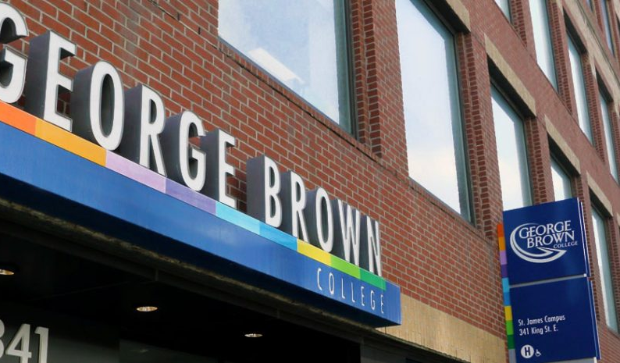
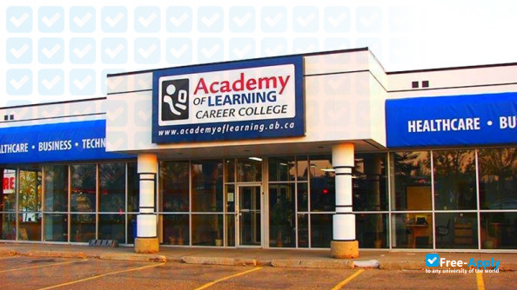
Why Study Colleges?
Canadian Post-Secondary System
Universities
Government Funded (Ryerson U) and Private (OCAD)
Colleges
Community (George Brown) 5 in the GTA
Private Career (Canadian Academy) 440 in Ontario
Tuition Fees
Admission Requirements
Permitted Work Hours and Regulations
“Value” of Diploma and Employment Opportunities

Slide 13
RESEARCH
QUESTIONS:
Why are so many Indian students choosing to come and study in GTA colleges?
Do they have a specific profile -- in terms of age, educational qualifications, and socio-economic class backgrounds?
How are they “choosing” these institutions?
METHODS:
India: Multiple college campuses in the NCR, edu-expo, in-depth, semi-structured, topical interviews with 5 key informants, including education agents and college lecturers
GTA: Analysis of web-pages of all community colleges and forty private career colleges, semi-structured, topical interviews with 10 key informants, including college staff (administrators/recruitment officers) and instructors at community and private colleges in the GTA, as well as Canadian education consultants; semi-structured, topical interviews with 30 ISs (19 from community colleges, and 11 from private career colleges)

Slide 14
Federal Government Policies
Community Colleges
Private Career Colleges
Education Agents in Canada
“Edu-brokers”
Education Agents in India
Social Networks
Banks and Private Lenders

Slide 15
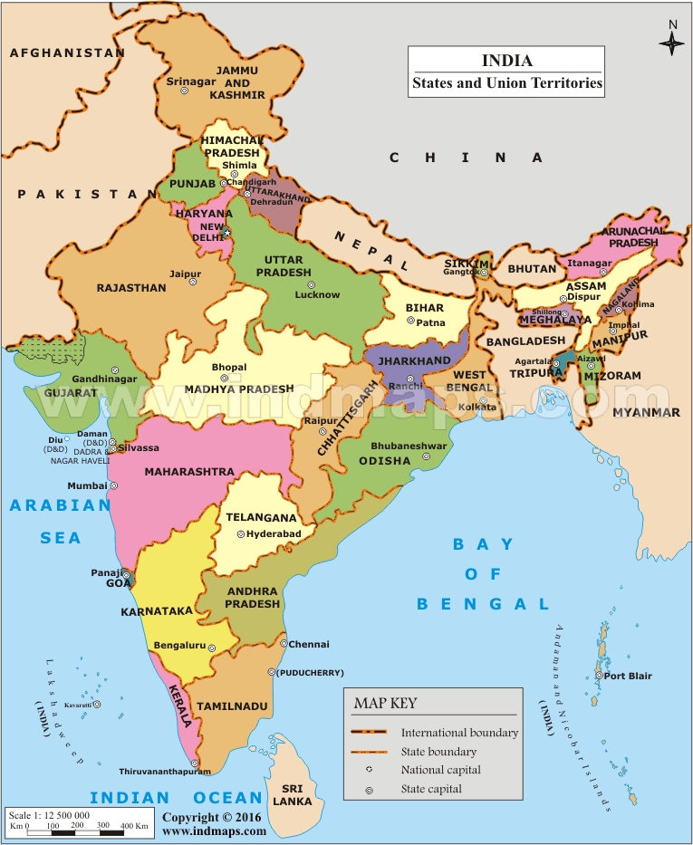
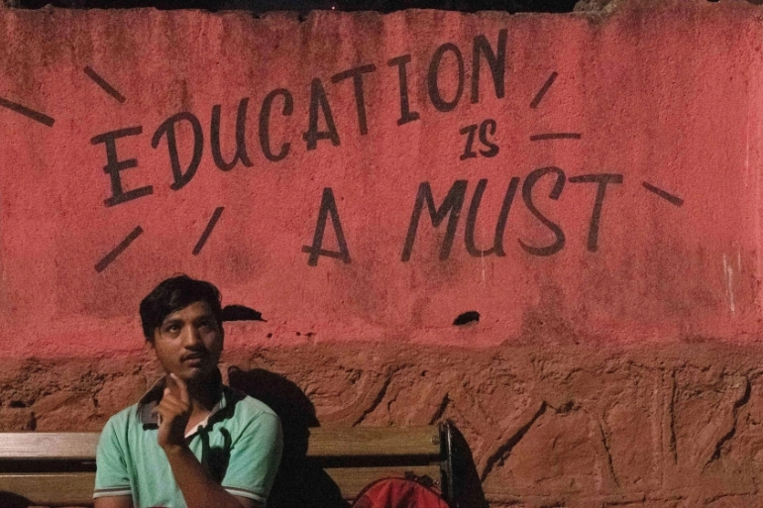
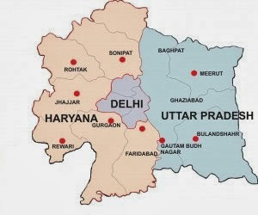
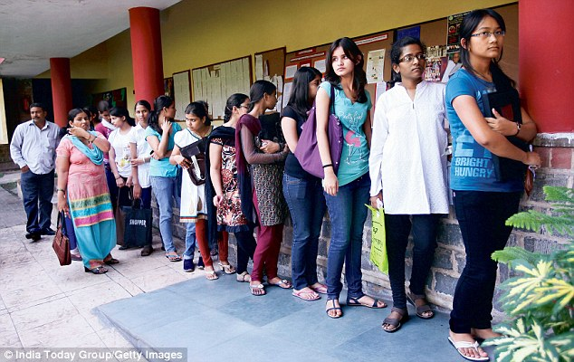
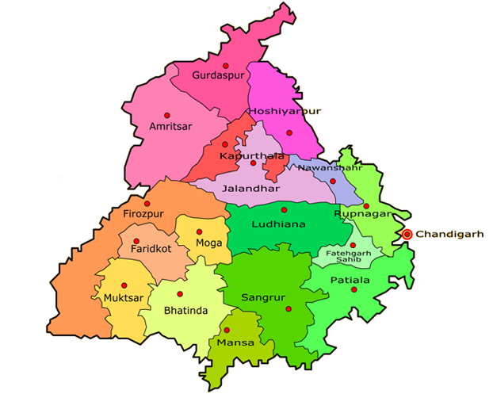
Foreign dreams: What's driving the exodus of youth from Punjab?
https://www.sbs.com.au/language/english/foreign-dreams-what-s-driving-the-exodus-of-youth-from-punjab
Notes:
S

Slide 16
Supporting a path to post-education resilience for Edu-immigrants
Francine Schlosser

Slide 17
Edu-immigrants
642,480 international students studied in Canada (IRCC, 2019)
60% of these students planned to apply for permanent residency in Canada (OECD, 2019)
75% sought post-graduation work placements
International Education = Pathway to Permanence

Slide 18
Research Imperative
Need to understand the experience of edu-immigrants coping with new social, political, and environmental structures in order to integrate into their adopted countries’ labour market and society;
How can regional and community stakeholders such as post-secondary institutions, settlement agencies, and local businesses support edu-immigrant resilience?

Slide 19
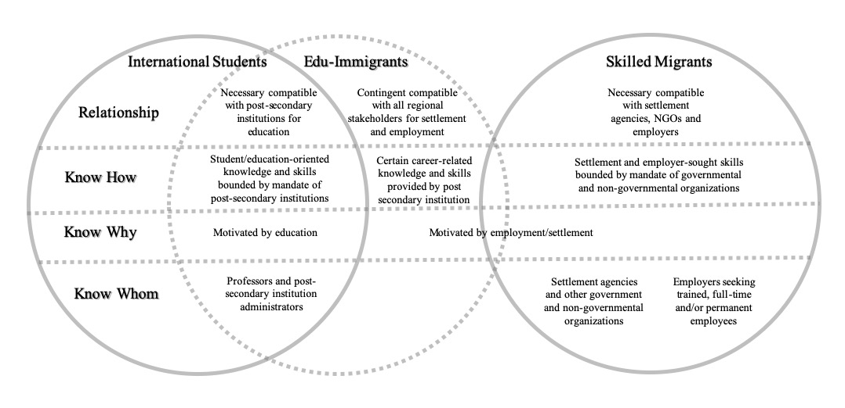
Edu-immigrants: Needs and Supports

Slide 20
Issues
Having clear educational and career goals
Most edu-immigrants know why and how to enhance their skills and competencies.
They don’t know whom to turn to for help in acquiring social connections, which are very important to access a spectrum of work experiences.
It is difficult for edu-immigrants to develop higher-level social capital/contacts without the support of campus and external stakeholders.

Slide 21
Service Gaps
Settlement agencies do not receive funding to support international students/edu-immigrants.
New ideas for more settlement support are not viewed as core to the educational mission of post-secondary institutions.

Slide 22
Solution: Cross-institutional Collaboration
Post-secondary institutions can help edu-immigrants by focusing on nurturing the three types of ‘knowing’ – ensuring they know their goals, aiding in the creation of the skills needed for lasting careers, and facilitating the establishment of a career-relevant social and professional network.
Cross-institutional collaboration among educational institutions, religious institutions, settlement agencies, and business members to provide and fund necessary services and develop new programs.

Slide 23
Entanglements of Canada’s Immigration and Official Language policies: Multilayered resilience
Luisa Veronis, University of Ottawa

Slide 24
Entanglements of Canadian policies
Francophone Minority Communities
International Students
Official Languages Act, 1969
Language policies
Immigration policies
Immigration and Refugee Protection Act, 2001
Charter of Rights and Freedoms, 1982
Notes:
3 min.
Monika
Let’s examine Canadian policies pertaining to the Francophone Immigration.
On one hand, Canadian federal government has language policies managing the status of French and English. The Official Languages Act gives equal rights to Francophone and Anglophone populations across the country, and those rights are further constitutionally enshrined in the Canadian Charter of Rights and Freedoms. However, they aim at maintaining the historical balance of power between two Canadian “founding” nations, namely, the British and the French. Linguistically speaking, immigrant population is seen as potentially integrating into one of those two groups.
On the other hand, Canadian immigration laws are seen as social, rather than language policies, relating in particular to settlement and citizenship issues. However, the 2001 Immigration and Refugee Protection Act states that one of the roles of immigration is “to support and assist the development of minority official languages communities in Canada” (section 3 (1) (b.1)), hence opening the door to a whole new set of laws combining immigration and linguistic issues. Those laws gravitate around the concept of “official language minority community”, and foster the concept of “francophone immigration in minority settings”.

Slide 25
Immigration and the vitality of Francophone communities & institutions
“The University of Ottawa wishes to carry a vision of the Francophonie that is a constant building block within a stronger, more powerful and more vibrant community. Through the values it conveys, the Francophonie can and must help consolidate ties and construct new forms of solidarity based on the sharing of the French language.
The recent upheavals in French-language postsecondary education in Ontario demonstrate more than ever that the Franco-Ontarian community must show resilience. In this context, the University of Ottawa, with its 13,000 Francophone students and thousands of Francophiles, remains more relevant than ever in our collective efforts to promote the Francophonie both here and abroad. Our actions contribute to the vitality of the Francophone community.”
Sanni Yaya, Vice-President, International and Francophonie, March 1, 2021

Slide 26
The University of Ottawa
The largest English-French bilingual university in the world
All on-campus services are offered in both English and French
Not all academic programs / courses are available in both languages
Internationalization
2019: international students account for 31.9% of all graduate students, of which over 90% were enrolled in English programs
Maintain & promote bilingualism
Since 2014, a tuition fee rebate for international students studying in French
English or French as a second language courses for full-time graduate students at no cost.
Figure 1. Number of international students enrolled at uOttawa from 2010 to 2019, by language and level of study. Source: uOttawa (n.d.). Student registrations by level of study, attendance status, student’s gender, language in use, immigration status, and co-op enrollment.

Slide 27
Context & research objectives
Most existing research examines challenges international students face in unilingual (English-language) contexts
Bilingual context: uOttawa and Ottawa-Gatineau
19 participants: international graduate students (MA/PhD) from diverse countries of origins
13 English-speaking & 6 French-speaking
Experiences with bilingualism:
Academics, social networks, employment, etc.
Table 1. Self-rated official language proficiency of interview participants
Self-rated official language proficiency |  | English-speaking participants (n=13) | French-speaking participants (n=6)
English | Elementary or no knowledge | 0 | 0
 | Intermediate | 2 | 1
 | Advanced or fluent | 10 | 5
French | Elementary or no knowledge | 10 | 0
 | Intermediate | 2 | 0
 | Advanced or fluent | 0 | 6

Slide 28
International students & linguistic capital
Academics: “The choices are a lot more limited. Forget about summer. Plus, in Education we have sub-programs. […] I’m in the health sub-program; there are even fewer courses. Inevitably we have to take whatever is available. No choice.” (Western Europe; translated from French)
On campus employment: “I can't apply for any mentorship [job] here [at uOttawa] because they need someone with French language. […] you have other languages like Russian and Belorussian. Who cares about those languages? Because those aren't mainstream languages here. It's not very pleasant because you can't really use opportunities to earn money.” (Eastern Europe)
Off campus employment: “I'm a Ph.D. student studying grand philosophical theories and I probably cannot get basic kinds of employment because they tell you: ‘you need to be bilingual’.” (Central America)
Campus tolerance: “Maybe that's one of the reasons why it's such a multicultural place. Because if you embrace both languages, you equally respect those languages and it shows there's not a superior one and you increase the possibility of other people coming here.” (South America)

Slide 29
Multilayered resilience
International students at uOttawa
Academics: bilingualism operates differently depending on academic programs = varied language requirements and experiences
Employment: bilingualism presents unique linguistic challenges & opportunities for accessing employment depending on language skills and field of study
Campus tolerance: International students celebrate the linguistic diversity attributed to bilingualism, but they are aware of its limitations in terms of supporting non-official languages
Post-secondary institutions
How to attract and support international students
Francophone communities & vitality
How to maintain essential post-secondary (and other) institutions

Slide 30
Acknowledgements
This research was supported by the Social Sciences and Humanities Research Council of Canada through the Building Migrant Resilience in Cities Partnership
Preston, V. PI, Belkhodja, C., Gabriel, C., Lochhead, C., Douglas, D., Dyson, D., Zikic, J., Hennebry, J., Shields, J., Veronis, L., Hynie, M., Mandell, N., Bhuyan, R., Ghosh, S. and collaborators. Migration and Resilience in Urban Canada - Immigration et résilience en milieu urbain (BMRC-IMRU): Discovering Strengths and Building Capacity, Partnership Grant. Social Sciences and Humanities Research Council of Canada, SSHRC#896-2016-1004, $2,499,525, 2016-2021.
We thank our community partners, research participants & research teams
For more information on the project: http://bmrc-irmu.info.yorku.ca/
Notes:
We thank the Partnership,
Our Partners on this project from IRCC
As well as everyone in the collaborative teams across Quebec and Ontario participating in this research.

Slide 31
Upcoming Webinar: Ottawa, is there a problem? International student numbers, job experiences and pathways to permanent residence March 9, 1:30-3:00 PM Contact: bmrcirmu@yorku.ca

