Slide 1
INTERNATIONAL STUDENT CONNECT (ISC) ÉTUDIANTS INTERNATIONAUX SE CONNECTENT (EIC)

Slide 2
International Student Connect (ISC)
International Student Connect (ISC) is a bilingual pilot project managed by COSTI.
The core purpose of the project is to identify, develop and implement an appropriate service response to the settlement needs of international students (IS) pursuing post-secondary education in Ontario. The project is funded by the Government of Ontario.
We currently work with 21 educational institutions and 16 SDAs.

Slide 3
Evaluation Report Findings
A clear and significant service gap exists in the IS population
Many ISOs at post-secondary institutions do not posses expertise in immigration and settlement matters
Settlement agencies are not funded to support IS
Educational institutions and the settlement sector committed to collaboration in support of international students

Slide 4
Evaluation Report Recomendations
Connect IS with the wider settlement services and community
Increase access to online resources and transfer of information - pre and post arrival webinars
Provide tailored and practical information geared to IS needs

Slide 5
Ontario
North Region
Sault College
Algoma University
Lakehead University
Confederation College
East Region
University of Ottawa (French)
York and Simcoe
Georgian College
Lambton College
Peel and Halton
Sheridan College
Lambton College
West Region
Mohawk Collège
Niagara Collège
University of Windsor
St. Clair Collège
Toronto
York University
Seneca College
Humber College
Lambton college
Glendon College
Centennial College
University of Toronto
George Brown Collège

Slide 6
Topics Covered
In-Person 20+
Banking and credit
Finding a place to live
Immigration pathways
Filing income taxes
Employment/Legal rights
Webinars 25+
Finding a place to live
Immigration pathways
Supporting IS spouses
Filing income taxes in Canada
Labor market and employment
Applying for PGWP
Services & Resources focused on:
Accompanying family members and graduating International Students

Slide 7
Challenges
International Students:
Financial constraints
Limited employment opportunities
Lack of clarity on pre-departure information
Wellness, mental health and settlement support & social networks
International Student Connect
Promotion of services and resources
Gap in understanding for support services for International Students
Notes:
Academia arrogance –
Urgency to link them to wider community network before they graduate
IS are a benefit to Post Secondary Institution but they are coming for PR – Thinking needs to change about how we view them.
Financial benefit Vs social obligation

Slide 8
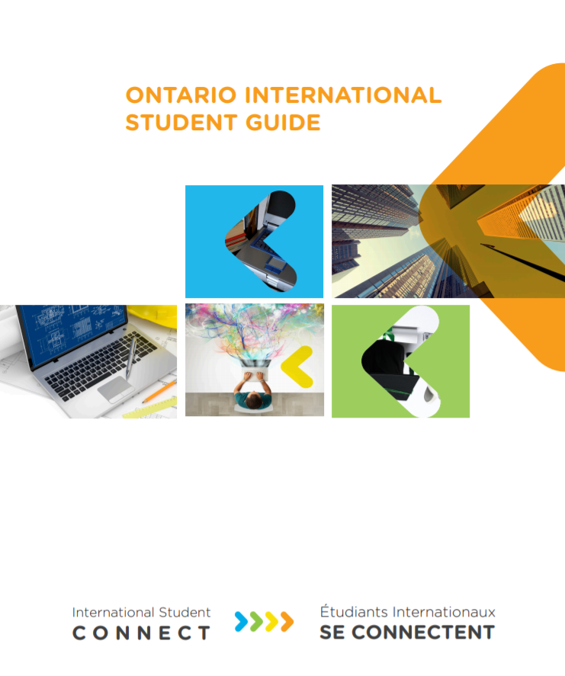
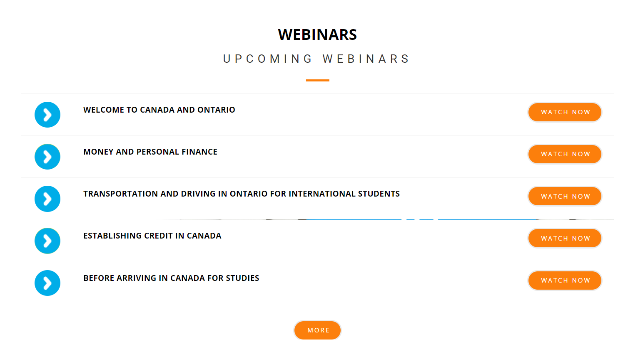
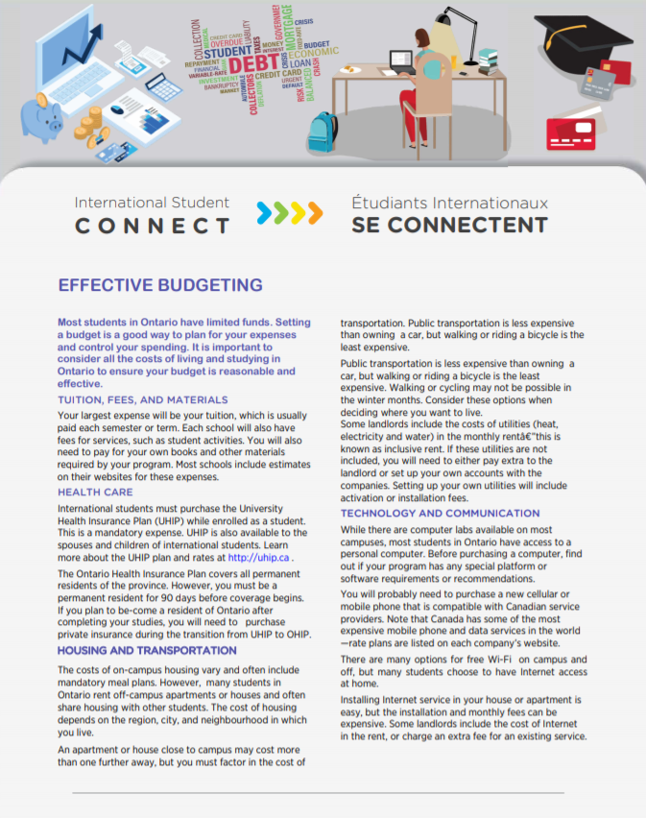
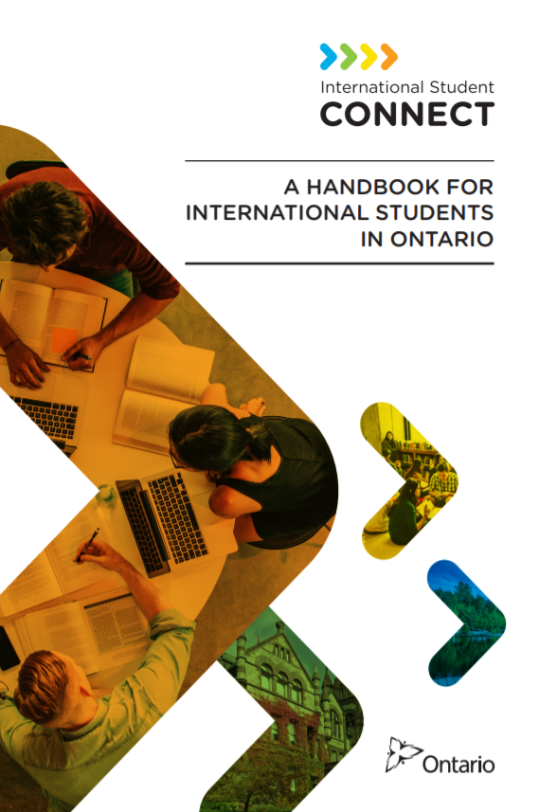
Thank You! Merci!
www.internationalstudentconnect.org
Notes:
employment will be easily accessed – Can work full time. .

