Slide 1
Exploring Resiliency Among International Students in the GTA: A Case Study of International Students from India Pursuing a Bachelors’ Degree at Community Colleges in the Greater Toronto Area
Dr. Sutama Ghosh
Associate Professor
Ryerson University
Toronto, Canada
Building Migrant Resilience in Cities Immigration et résilience en milieu urbain

Slide 2
Literature Review
ISs comprise over a tenth of all students in Canadian universities, and among those, more than a quarter are Chinese (28%), closely followed by Indians (25%)
Most ISs to Canada seek undergraduate diplomas, and although a majority still gravitate toward universities in Ontario, British Columbia and Quebec, a significant proportion (almost 20%) attend community colleges
Bozheva (2018) terms this trend as “bachelorization”
Building Migrant Resilience in Cities Immigration et résilience en milieu urbain

Slide 3
Click here to edit the title
Literature Review
Research has progressed following two main strands of inquiry:
first, the processes of ISM to Canada
secondly, their settlement challenges
Study groups: most Canadian research has focused on Chinese students and at Canadian universities
Processes of ISM to Canada:
Overwhelming focus on the structure-agency duality, with an emphasis on structural controls
Transnational networks remain little explored
k here to add text
Building Migrant Resilience in Cities Immigration et résilience en milieu urbain

Slide 4
Click here to edit the title
Literature Review
Settlement Challenges:
Pedagogical Methods and Study Patterns (Zhou and Zhang 2014)
discrimination (e.g., micro-aggression, racial invalidation) that they face from their peer groups and teachers/professors -- ISs suffer from mental health related issues, such as anxiety, acculturative stress, and depression (Wu et al. 2015)
Housing
Employment
Pathways to Permanent Residency
Consequently, ISS require a range of support services (e.g., for housing, employment, as well as for their general physical and mental well-being).
Building Migrant Resilience in Cities Immigration et résilience en milieu urbain

Slide 5
Potential Research Gaps
A lack of comparative research on ISs pursing a Bachelor’s degree at different educational institutions (i.e., universities and community colleges) located within the same city
Little is known about any similarities and differences in their recruitment patterns and processes, settlement challenges, as well as on and off campus support that is needed/available/accessed
By overstressing structural determinism, little light has been shed on the element of agency, differentiated by the axes of social identities (e.g., ‘race’, class, and gender)
It is not known whether there are any similarities and differences among ISs attending Canadian universities and community colleges with respect to how they might navigate the existing structural controls and barriers to settlement, at both pre- and post-migration stages
The influence of transnational linkages (institutional and social) on their migration processes and settlement experiences remains understudied
Building Migrant Resilience in Cities Immigration et résilience en milieu urbain

Slide 6
Research Objectives
Objective 1: Document the Reasons for and Processes of ISM to Canada by focussing specifically on those who arrive from the same sending country to pursue a Bachelor’s degree in Canada, but attend different types of institutions (i.e., universities/colleges) within the same city
Objective 2: Identify the factors that influence their socio-demographic characteristics (e.g., age, gender, economic class, disciplinary backgrounds, and language proficiencies) differentiated by the types of institutions (i.e., universities/colleges) they attend within the same city
Objective 3: Compare the Similarities and Differences in the challenges they may face in their settlement process, the type of support (e.g., from their institutional/social networks) they may need on and off campus, and the availability and accessibility of those resources
Building Migrant Resilience in Cities Immigration et résilience en milieu urbain

Slide 7
Proposed Study
Comparing Institutions and Associated Geographies | Universities | Community Colleges
Downtown Toronto | U of T St. George Campus Ryerson U | George Brown
Inner Suburbs (Etobicoke, North York, York, East York and Scarborough) | U of T Scarborough York U | Seneca/ Humber
Outer Suburbs (Brampton, Mississauga, King City, Oshawa) | U of T Mississauga OIT | Centennial Sheridan
Building Migrant Resilience in Cities Immigration et résilience en milieu urbain

Slide 8
Some Initial Findings

Slide 9
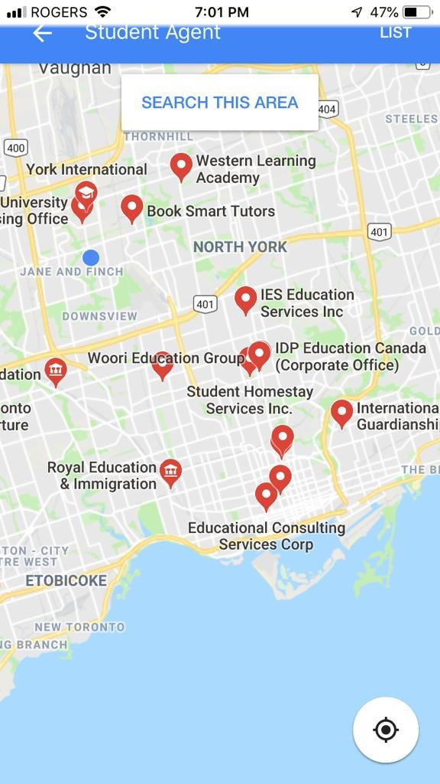
https://isrc.ca/
https://www.collegesinstitutes.ca/what-we-do/

Slide 10
Three Pronged Approach to Recruitment?
Publicly Funded Canadian Universities/Colleges and other Educational Institutions – serving as their own “agents”
Private Agencies in India and Canada acting as “middle men” for Canadian public and Private Institutions
Private Agencies operating “Internationally”

Slide 11
Building Migrant Resilience in Cities/Immigration et résilience en milieu urbain
http://bmrc-irmu.info.yorku.ca/
@bmrc_irmu
@BMRCIRMUResearch
BMRC - IRMU

