Slide 1
International Students in
Ontario and Quebec
A Comparative Analysis
Marshia Akbar
Postdoctoral Research Fellow
York University
Toronto
Building Migrant Resilience in Cities Immigration et résilience en milieu urbain

Slide 2
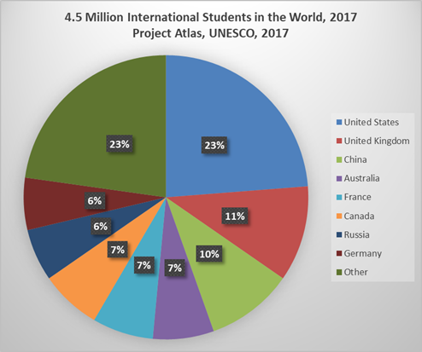
Why Focus on International Students?
CBIE research highlights record growth in ISs in Canada:
In 2017, 494,525 international students in Canada
One of top 3 student destinations
Growing numbers
17% increase over 2016
34% increase between 2014 and 2017
Studies focus on ISs’:
access to social services
integration challenges
economic contributions
transition from temporary to permanent status
Building Migrant Resilience in Cities Immigration et résilience en milieu urbain

Slide 3
Objectives and Data Sources
Data Sources
Non-Resident File (NRF), 1980-2015
Migrants who entered Canada with a non-permanent resident visa.
Permanent and Non-Permanent Resident File (PNRF), 1980-2015
ISs who became permanent residents.
Canadian Bureau for International Education
Other IRCC data
Limitations:
NRF contains very limited information
All numbers are rounded to multiples of 50
Limited information at the CMA level
Objectives:
The study compares the flow of ISs and their social characteristics between Ontario and Quebec and selected CMAs in the two provinces
Building Migrant Resilience in Cities Immigration et résilience en milieu urbain

Slide 4
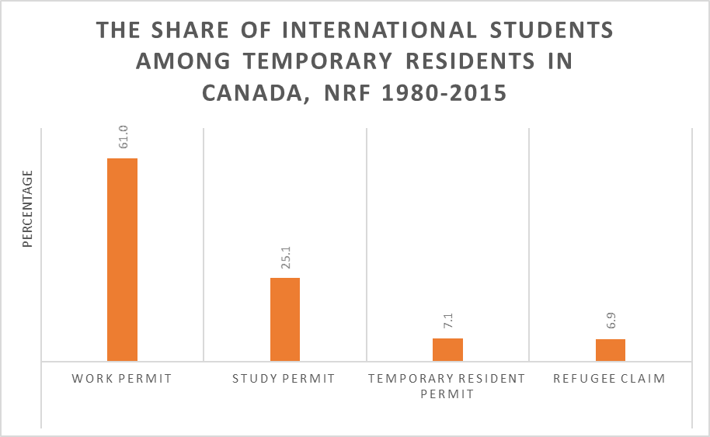
International Students: Total Number
1,373,800 migrants entered Canada with a study permit between 1980 and 2015.
Study permit holders comprised one quarter of all temporary residents (5,476,300) entering Canada between 1980 and 2015.
Building Migrant Resilience in Cities Immigration et résilience en milieu urbain

Slide 5
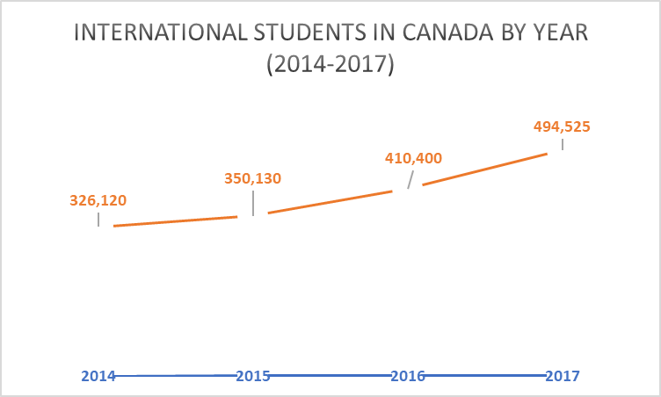
International Students: Policy Targets
The number of ISs in 2017 surpassed the Government of Canada’s goal of receiving 450,000 ISs by 2022.
Building Migrant Resilience in Cities Immigration et résilience en milieu urbain

Slide 6
International Students: Countries of Origin
Top 10 Source Countries of International Students in Canada, 2017
China | 28% | 140,530
India | 25% | 123,940
South Korea | 5% | 23,050
France | 4% | 21,925
Vietnam | 3% | 14,095
United States of America | 3% | 13,975
Brazil | 2% | 11,775
Nigeria | 2% | 10,880
Japan | 2% | 7,950
Saudi Arabia | 2% | 7,640
Diversity among ISs has declined in recent years with 65 percent of all ISs coming from the top five countries of citizenship.
Building Migrant Resilience in Cities Immigration et résilience en milieu urbain

Slide 7
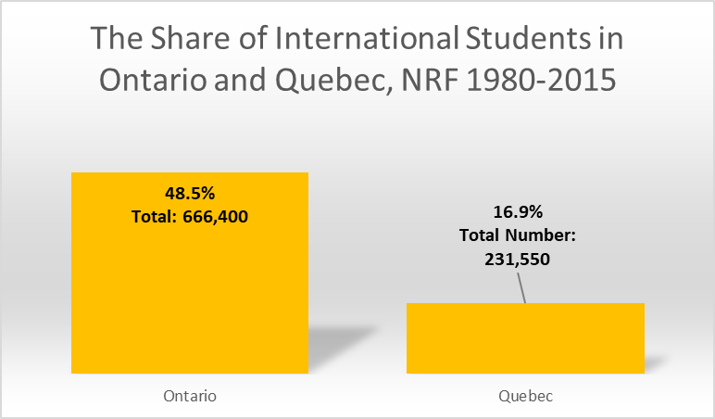
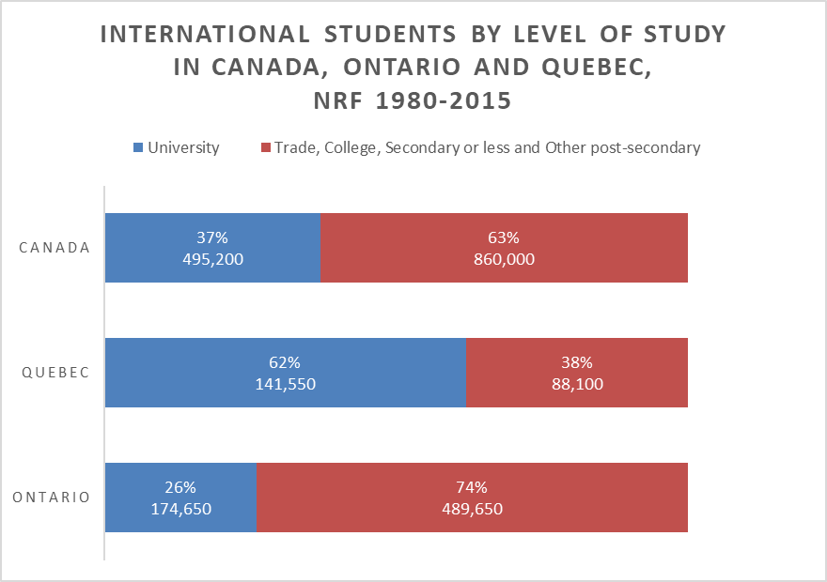
International Students: Level of Study in Quebec and Ontario
Most ISs in Ontario attended non-university institutions, while the majority in Quebec attended universities.
Destination of almost half of ISs was Ontario, while only 17% reported Quebec as their destinations.
Building Migrant Resilience in Cities Immigration et résilience en milieu urbain
Notes:
Educational systems are different.
In Quebec, CEGEP is mainly pre-university, however, at least one report shows ISs in non-university programs mostly enroll in 3-year technical, usually trades
programs at CEGEP.
In Ontario, Community colleges are an alternative to university. They offer diplomas in a wide range of occupations including trades as well as offering degrees on a limited basis. A two-year postgraduate diploma from a college may qualify ISs for permanent residence.

Slide 8
International Students:
Level of Study in Selected CMAs
University-going ISs dominate in Quebec City, Sherbrooke and Montreal.
Toronto has a large proportion (82%) of college, trades and other non-university secondary institutions.
In Kitchener-Waterloo, majority are enrolled in universities.
Level of Study | University | College, trades and other non-university
Toronto | 77,200 | 357,450
Ottawa-Gatineau | 26,000 | 30,100
Kitchener-Waterloo | 9,500 | 6,750
Windsor | 18,700 | 27,850
Montreal | 111,250 | 77,900
Sherbrooke | 6,600 | 1,850
Quebec City | 13,850 | 4,150
Building Migrant Resilience in Cities Immigration et résilience en milieu urbain

Slide 9
International Students:
Transition to Permanent Residence
Where do the international students who became permanent residents reside?
The percent of all international students in Canada who gained PR status by place of residence
Of 1,373,800 ISs who entered between 1980 and 2015, 525,300 (38%) became permanent residents.
About half (51%) of ISs who gained PR status resided in Ontario.
Only 16% lived in Quebec.
 |  | Number | Percent
 | Quebec City | 6,750 | 1.3
 | Sherbrooke | 1,950 | 0.4
 | Montreal | 71,300 | 13.6
 | Ottawa-Gatineau | 22,850 | 4.3
 | Kitchener-Waterloo | 7,250 | 1.4
 | Toronto | 197,650 | 37.6
 | Windsor | 4,300 | 0.8
 | Other CMAs | 213,250 | 40.6
 | Total | 525,300 | 100.0
Building Migrant Resilience in Cities Immigration et résilience en milieu urbain

Slide 10
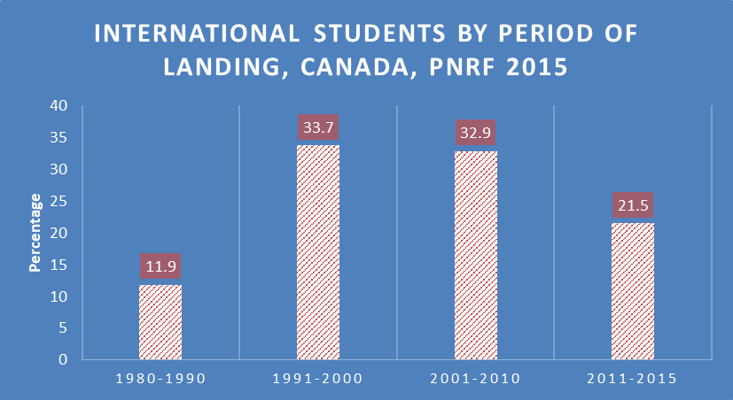
International Students: Landing Period
Building Migrant Resilience in Cities Immigration et résilience en milieu urbain

Slide 11
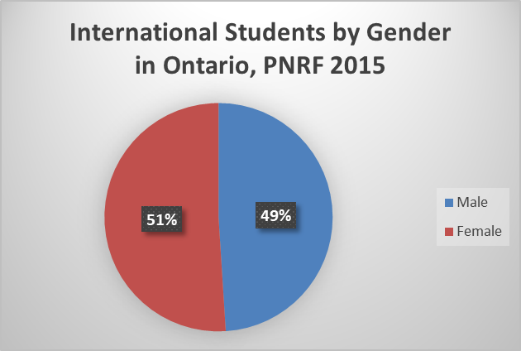
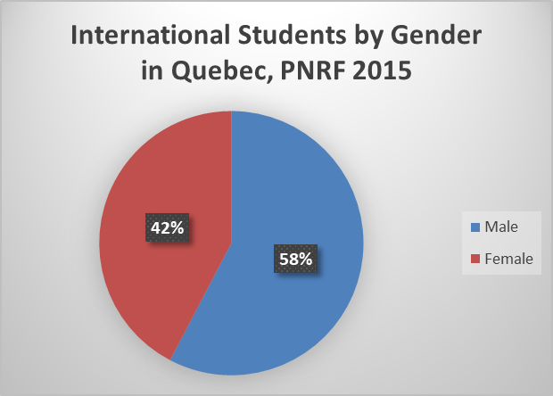
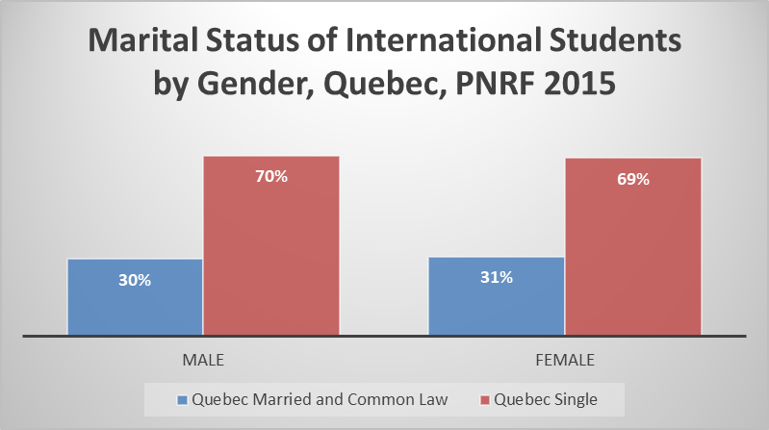
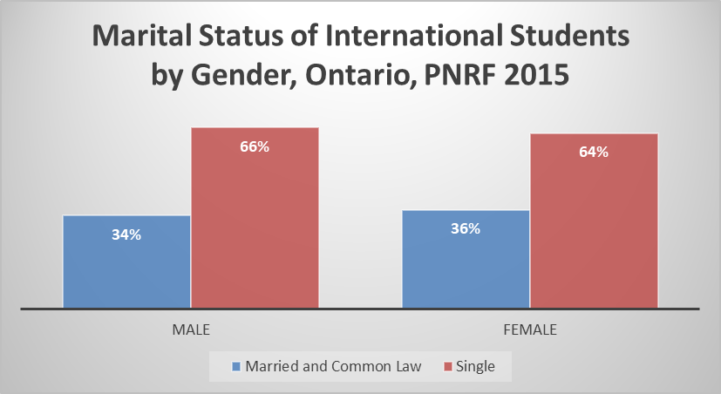
International Students: Gender
In Ontario, percentages of male and female students that become permanent residents are almost equal
In Quebec, male students are a larger proportion of ISs that land.
The majority of men and women who gained PR status is single in both provinces.
Building Migrant Resilience in Cities Immigration et résilience en milieu urbain

Slide 12
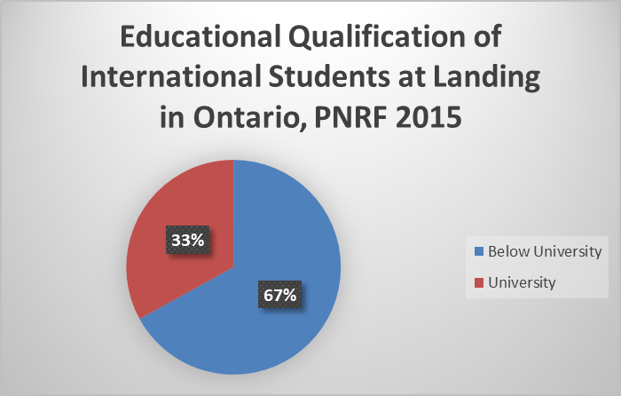
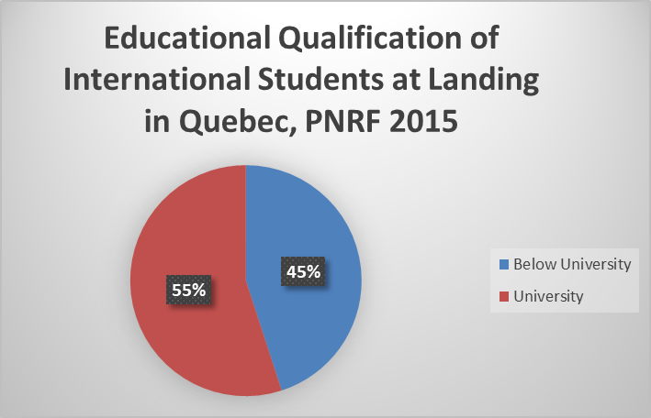
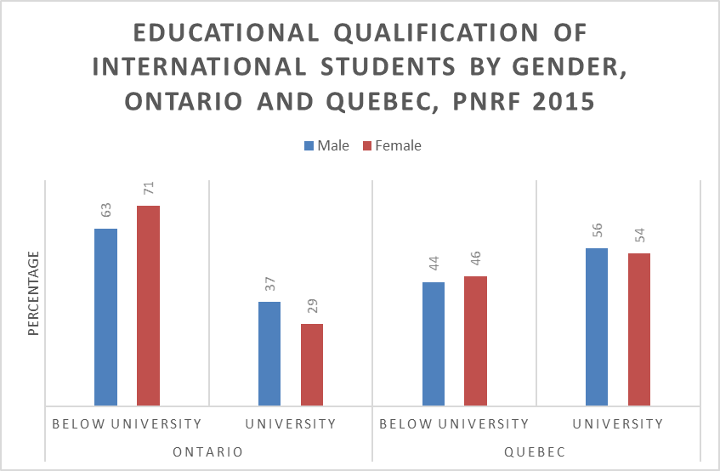
International Students’ Educational Qualifications by Gender
More than half of all ISs who became permanent residents in Quebec were university educated.
Only one third in Ontario had been enrolled at a university.
Male ISs are more likely to be university educated than their female counterparts in both provinces, but the gender gap is larger in Ontario than in Quebec.
Building Migrant Resilience in Cities Immigration et résilience en milieu urbain

Slide 13
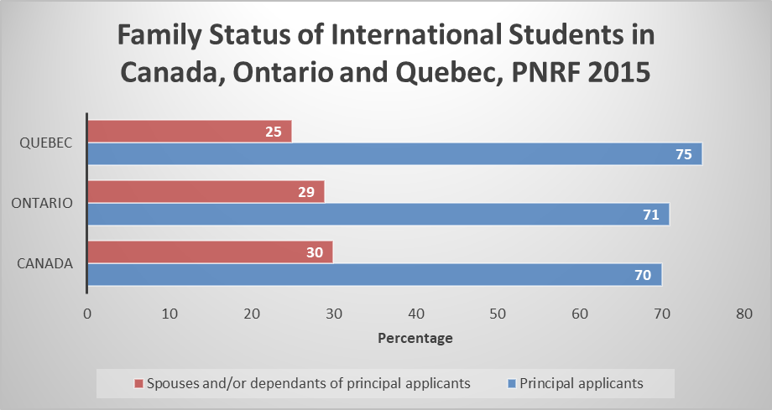
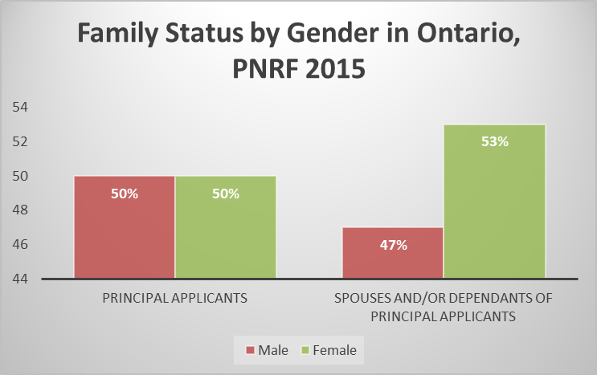
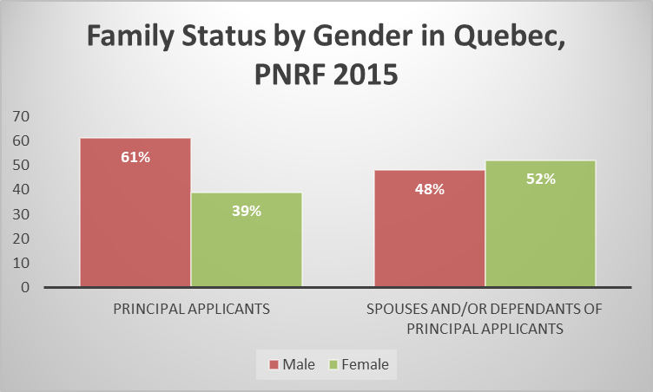
International Students:
Principal Applicants by Gender
Family Status by Gender
The majority of ISs in Ontario and Quebec landed as principal applicants.
Male ISs comprised a larger share of principal applicants than their female counterparts in Quebec.
Building Migrant Resilience in Cities Immigration et résilience en milieu urbain

Slide 14
Key Findings
If international students were planning to become permanent residents, only 38% succeeded between 1980 and 2015.
Place matters
International students are more likely to enroll at universities in Quebec than in Ontario.
Unlike in Ontario, men comprise the majority (58%) of ISs who became permanent residents in Quebec.
There is a gender gap among university-educated ISs with men more likely to enroll at universities and the gap is larger in Ontario than in Quebec.
What do provincial and metropolitan differences mean for settlement and immigrant-serving organisations?
Building Migrant Resilience in Cities Immigration et résilience en milieu urbain

Slide 15
Building Migrant Resilience in Cities/Immigration et résilience en milieu urbain
http://bmrc-irmu.info.yorku.ca/
@bmrc_irmu
@BMRCIRMUResearch
BMRC - IRMU

